Slide 1
Chapter 41

Slide 2
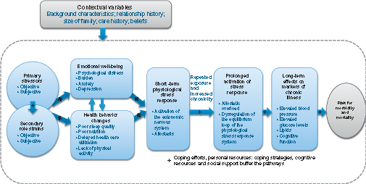
Figure 1 A biopsychosocial stress process model.

Slide 3
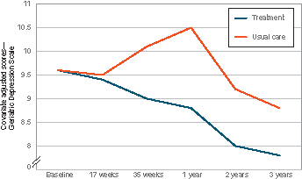
Figure 2 Long-term effects on depression of the New York University Caregiver Intervention.
Data from Mittelman et al.³¹

